Slide 1
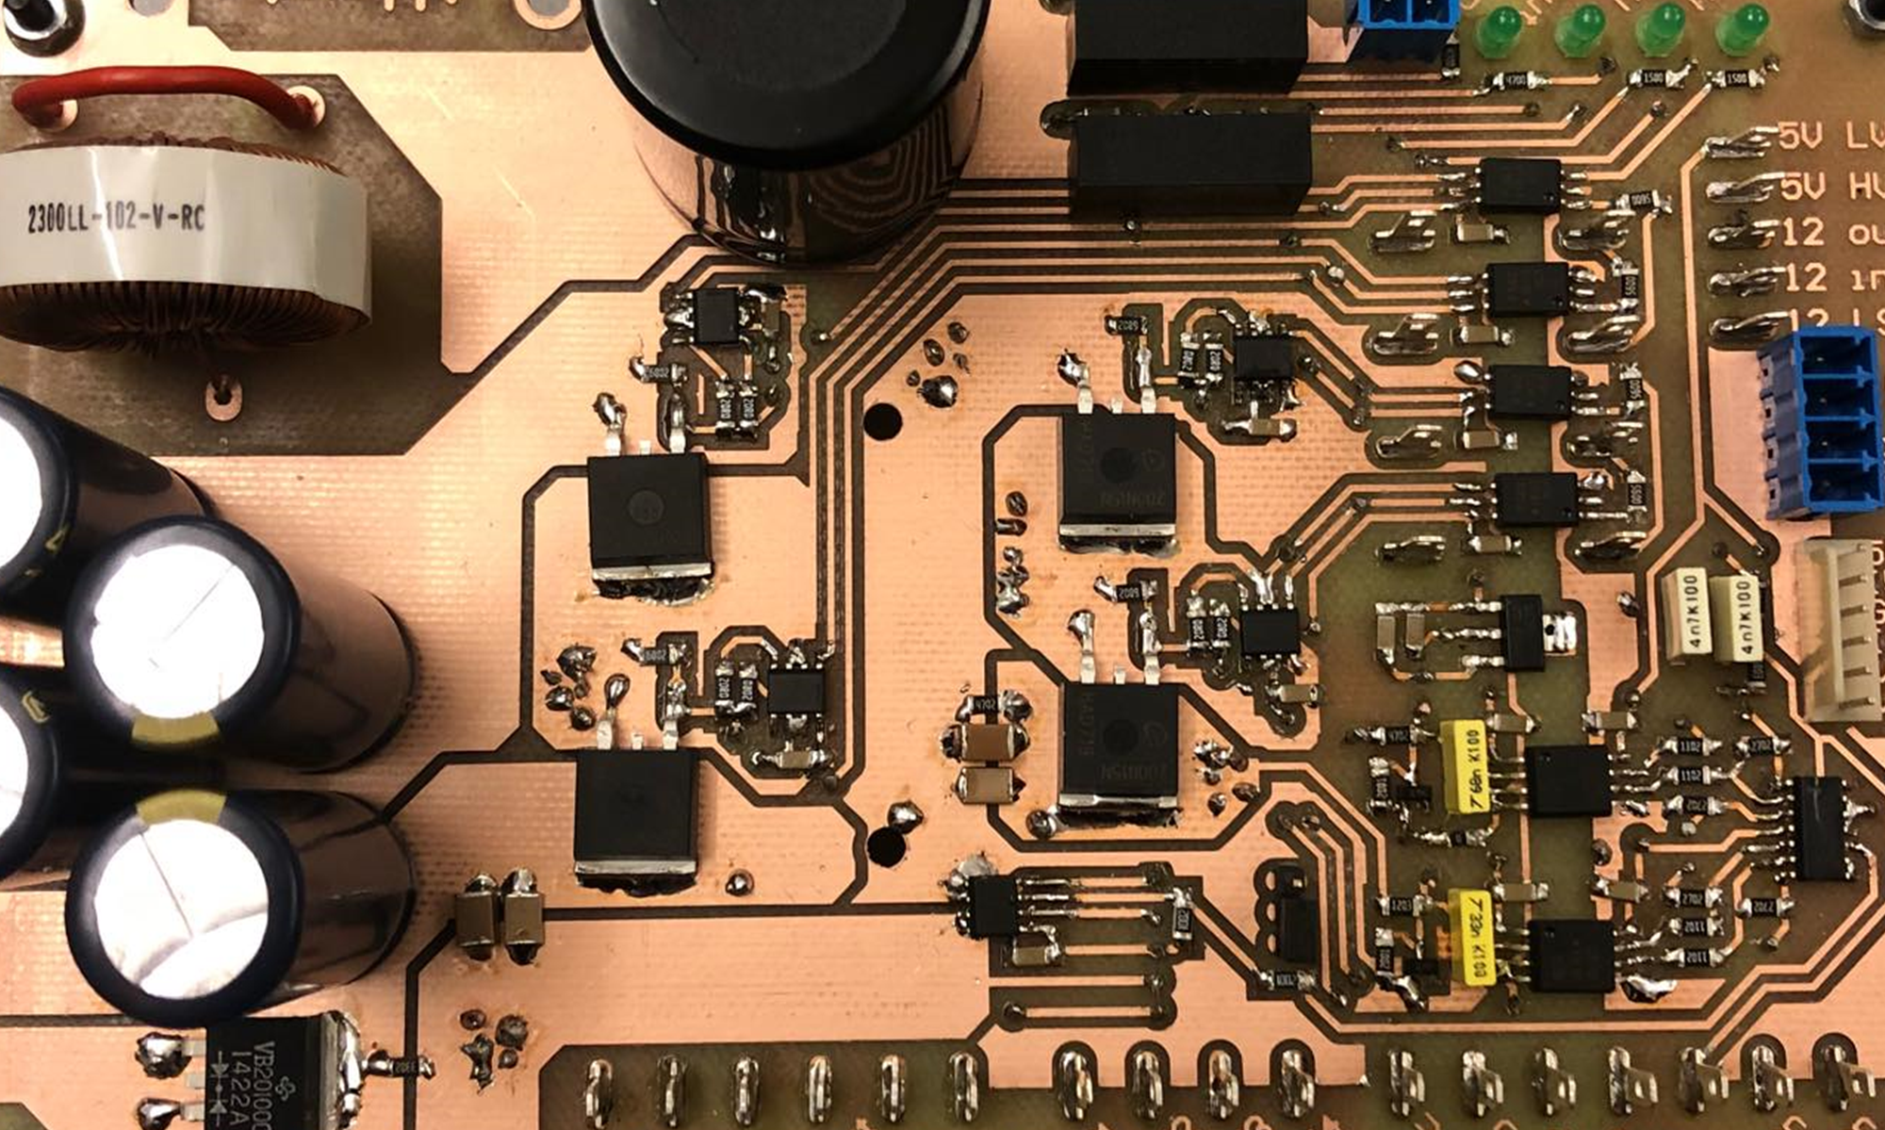
Questions
Notes:
Motivation
Existing problems
What is a MIC
Why a MIC
Problem statement

Slide 2
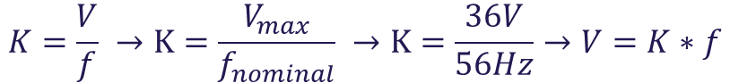

Open loop control – V/f
Open loop control useful for debugging and verifying.
V/F relates voltage and frequency through a constant.
$$K=\frac{V}{f} →K=\frac{V_{max}}{f_{nominal}} →K=\frac{36V}{56Hz}→V=K∗f$$
Duty cycle will be then limited according to V.
At 0Hz, duty cycle is always d = 0. At $f_{nominal}$, the max duty cycle is d = 1.

Slide 3
Open loop control – V/f
Open loop control useful for debugging and verifying.
V/F relates voltage and frequency through a constant.
$$K=\frac{V}{f} →K=\frac{V_{max}}{f_{nominal}} →K=\frac{36V}{56Hz}→V=K∗f$$
Duty cycle will be then limited according to V.
At 0Hz, duty cycle is always d = 0. At $f_{nominal}$, the max duty cycle is d = 1.

Slide 4
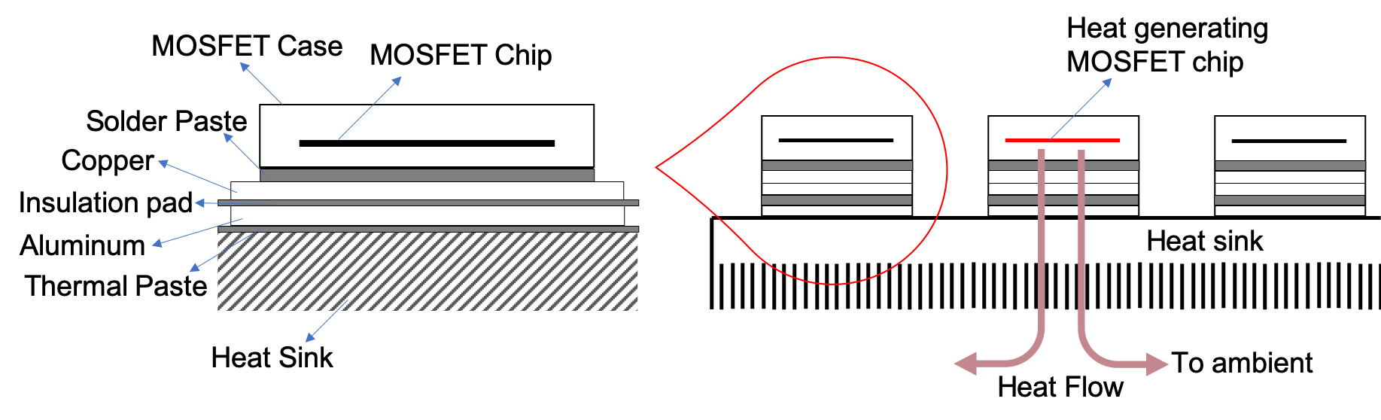
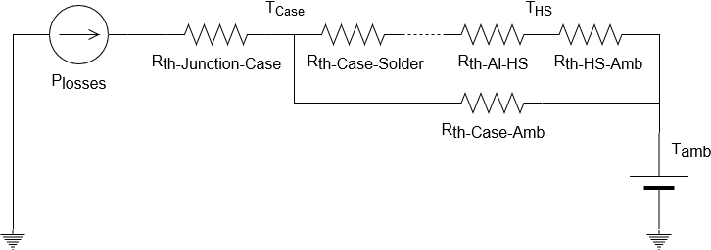



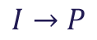
Thermal losses in MOSFETs
Modelled like an electrical circuit where:
$$I→P$$
$$V→T$$
$$R→R_{th}$$
$$∆T=P·R_{th}$$

